Slide 1


Slide 2
SIRT-EXCELLENCE
Guided By: Presented By:
Prof. Tarique Zaya Khan Vivek Kumar
        Daya Shankar Paul

Slide 3
DEVELOPERS
Vivek Kumar
Daya Shankar Paul

Slide 4
ABSTRACT
  OBJECTIVE:
Library management system is a project which aims in developing a computerized
system to maintain all the daily work of library .This project has many features
which are generally not availiable in normal library management systems like
facility of user login and a facility of teachers login .It also has a facility of admin
login through which the admin can monitor the whole system .It also has facility
of an online notice board where teachers can student can put up information about
workshops or seminars being held in our colleges or nearby colleges and librarian
after proper verification from the concerned institution organizing the seminar can
add it to the notice board . It has also a facility where student after logging in their
accounts can see list of books issued and its issue date and return date and also the
students can request the librarian to add new books by filling the book request
form.The librarian after logging into his account ie admin account can generate
various reports such as student report , issue report, teacher report and book report
Overall this project of ours is being developed to help the students as well as staff
of library to maintain the library in the best way possible and also reduce the
human efforts.

Slide 5
MODULES
Registration module
Administrative module
Member module

Slide 6
1. Registration module
In registration module first we ask member to give his details.After registering with us the member can logon to his/her own account and can view all book issue details such as Issue Date, Book Title,Returning Date and No. of Book issued.

Slide 7
2. Administrative module
Administrative module is provided for the sake of administrators to manage the site and update the content at regular intervals, The major operations included in this module are:
Add New Books Detail.
View the Members list.
View the Issued Books and available books .
Remove the members and books.
Updating the book detail.

Slide 8
3. Customer module
This module is meant for customers, where a user logging into his/her owns account will view this panel. The major operations included in this module were
View detail of all available books in library.
View Borrowed Books.
Send feedback

Slide 9
3. SCOPE & PURPOSE
3.1 PURPOSE:
The project aims and objectives that will be achieved after completion of this project are
discussed in this subchapter. The aims and objectives are as follows:
Online book issue
Request column for librarian for providing new books
A separate column for digital library
Student login page where student can find books issued by him/her and date of return.
A search column to search availability of books

Slide 10
  SCOPE:
The project has a wide scope, as it is not intended to a particular organization. This project is going to develop generic software, which can be applied by any businesses organization. More over it provides facility to its customer. Also the software is going to provide a huge amount of summary data.

Slide 11
PROPOSED SYSTEM:
The Proposed system ensures the complete freedom for users, where user at his own system can logon to this website and can book his ticket. Our proposed system allows only registered users to book the tickets, view timings and cancel their tickets.
In this Proposal the entire work is done on online and ticket with id is also provided for passengers as a print document. Here passengers can send their queries and suggestions through a feedback form.

Slide 12
SYSTEM DESIGN
Unified Modeling Language:
UML stands for Unified Modeling Language. It is a third generation method for specifying, visualizing and documenting the artifacts of an object oriented system under development. Object modeling is the process by which the logical objects in the real world (problem space) are represented (mapped) by the actual objects in the program (logical or a mini world). This visual representation of the objects, their relationships and their structures is for the ease of understanding. This is a step while developing any product after analysis.

Slide 13
The Unified Modeling Language encompasses a number of models.
Use case diagrams
Class diagrams
Sequence diagrams

Slide 14
Use Case Diagram:
Use case diagram consists of use cases and actors and shows the interaction between them. The key points are:
The main purpose is to show the interaction between the use cases and the actor.
To represent the system requirement from user’s perspective.
The use cases are the functions that are to be performed in the module.
An actor could be the end-user of the system or an external system.

Slide 15
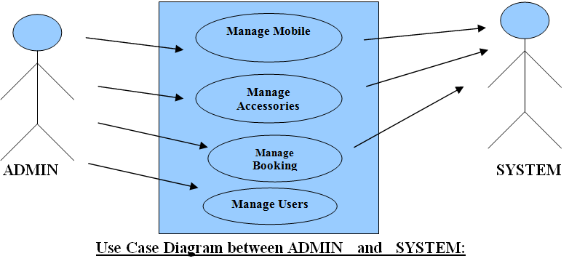

Slide 16
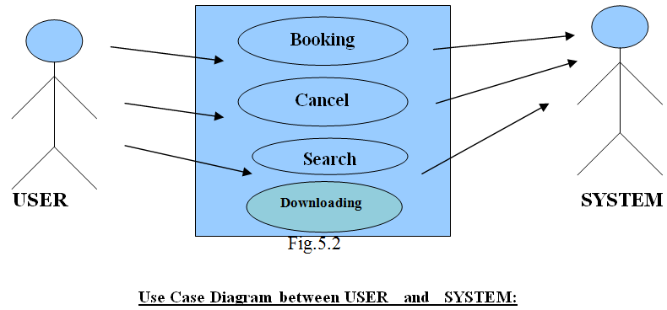

Slide 17
Sequence Diagram:
The purpose of sequence diagram is to show the flow of functionality through a use case. In other words, we call it a mapping process in terms of data transfers from the actor through the corresponding objects.

Slide 18


Slide 19
Login
Application
Database
Login
:Request
:Validate()
:executeQuery()
Response
Show Result
Failed:show()

Slide 20
Login
Application
Database
Login
:Request
:Validate()
:executeQuery()
Response
Show Result

Slide 21


Slide 22
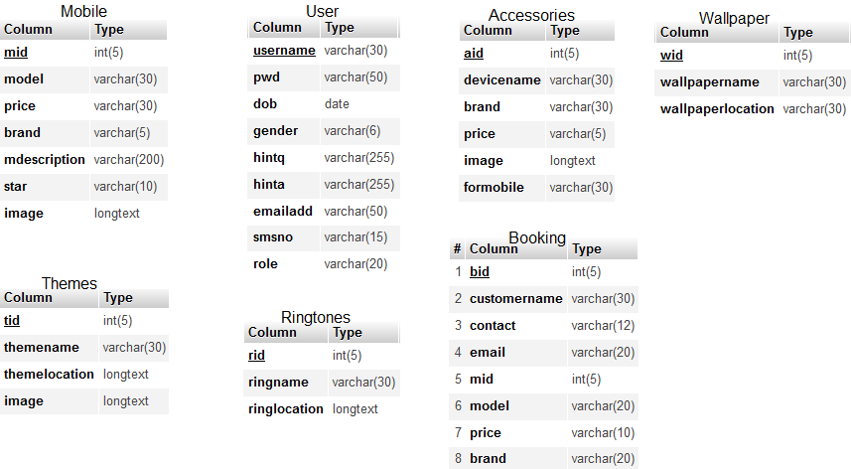

Slide 23
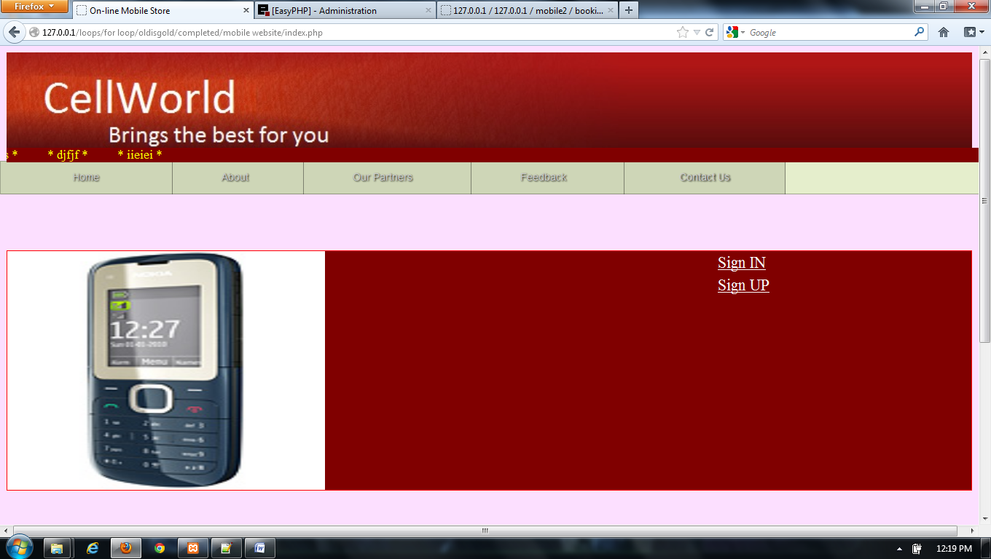
SCREEN SHOTS

Slide 24
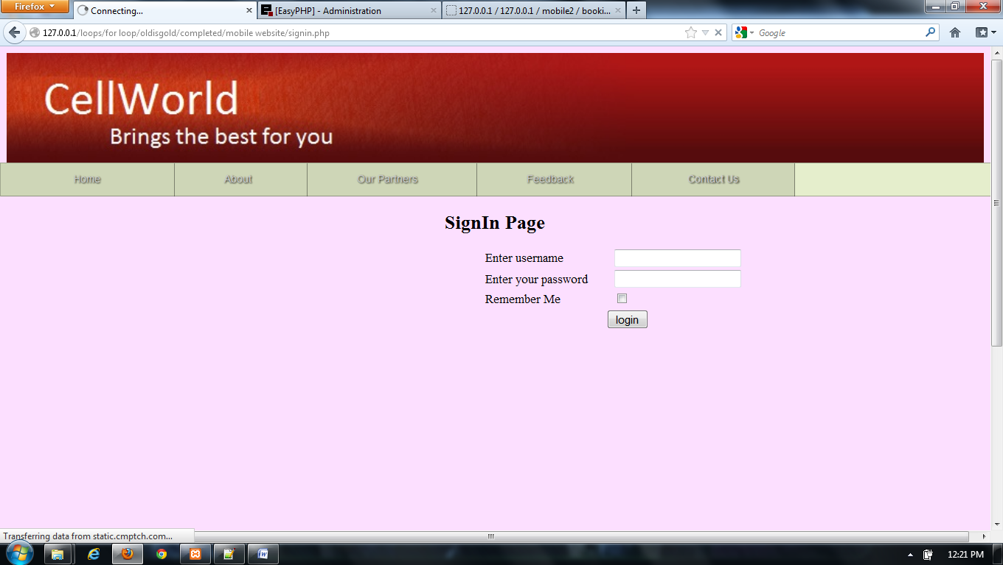
LOGIN FORM

Slide 25
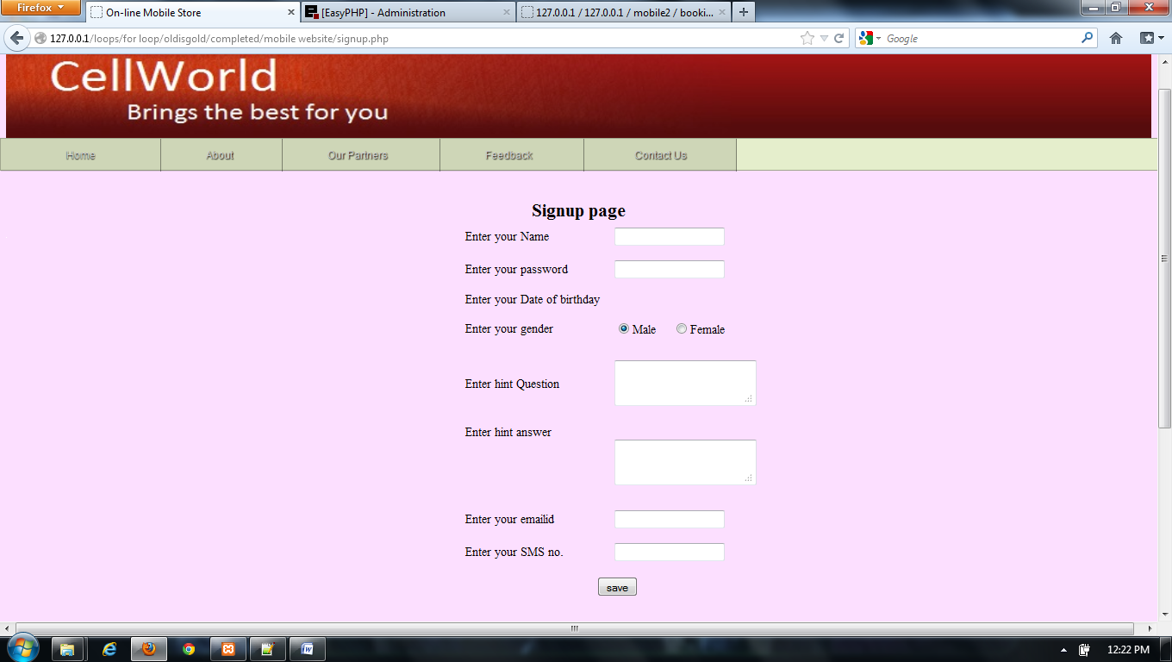
REGISTRATION FORM

Slide 26
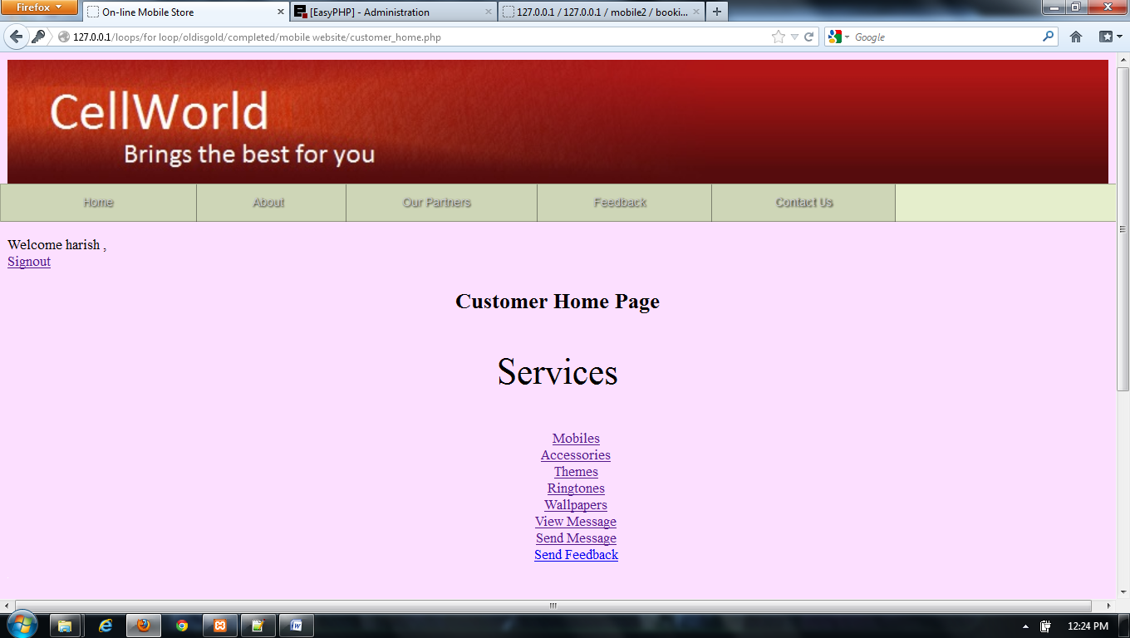
WELCOME USER PAGE

Slide 27
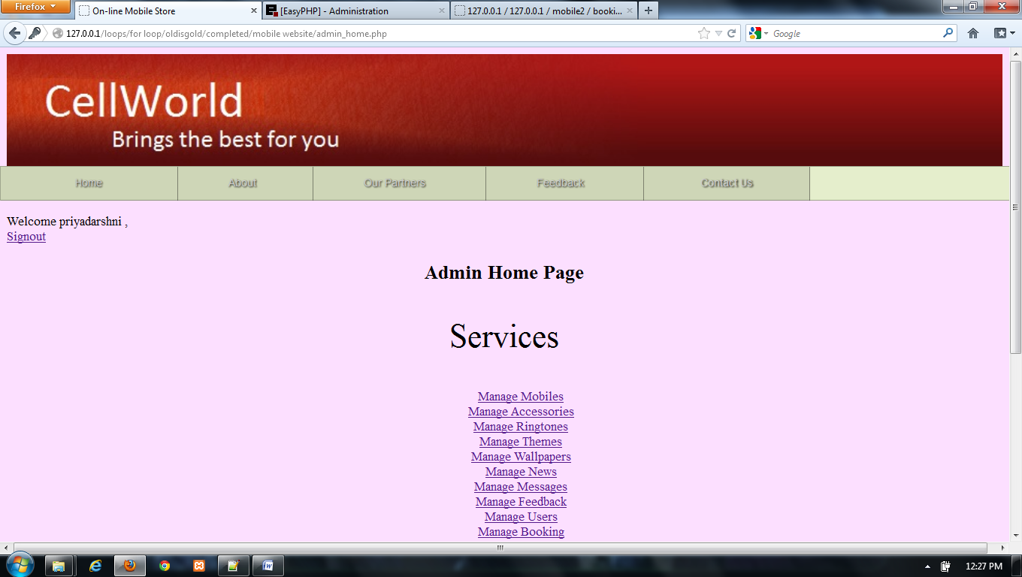
ADMIN HOME PAGE

Slide 28
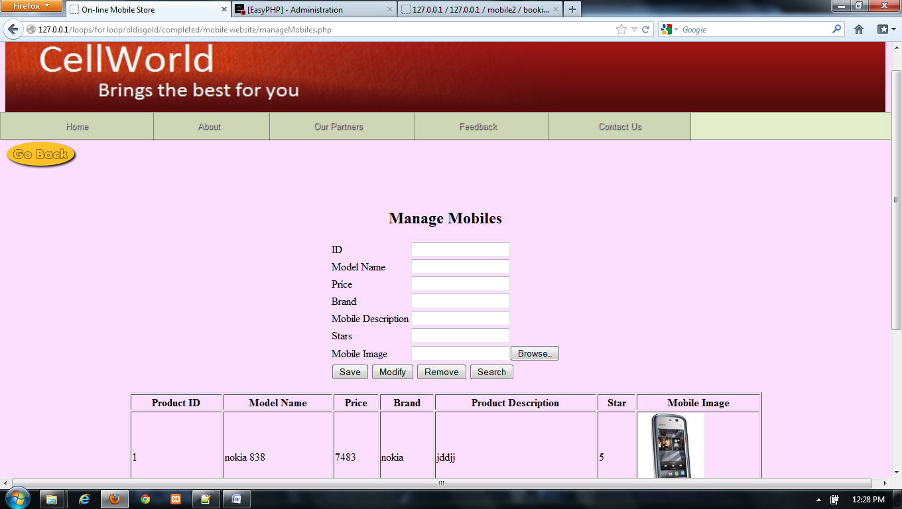
MANAGE MOBILE PAGE

Slide 29
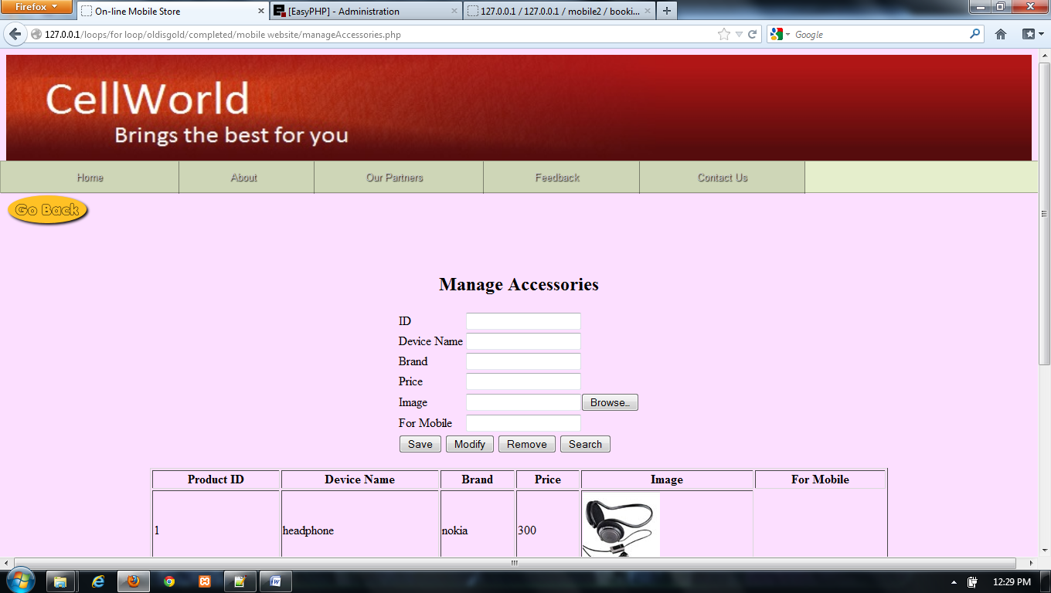
MANAGE ACCESSORIES PAGE

Slide 30
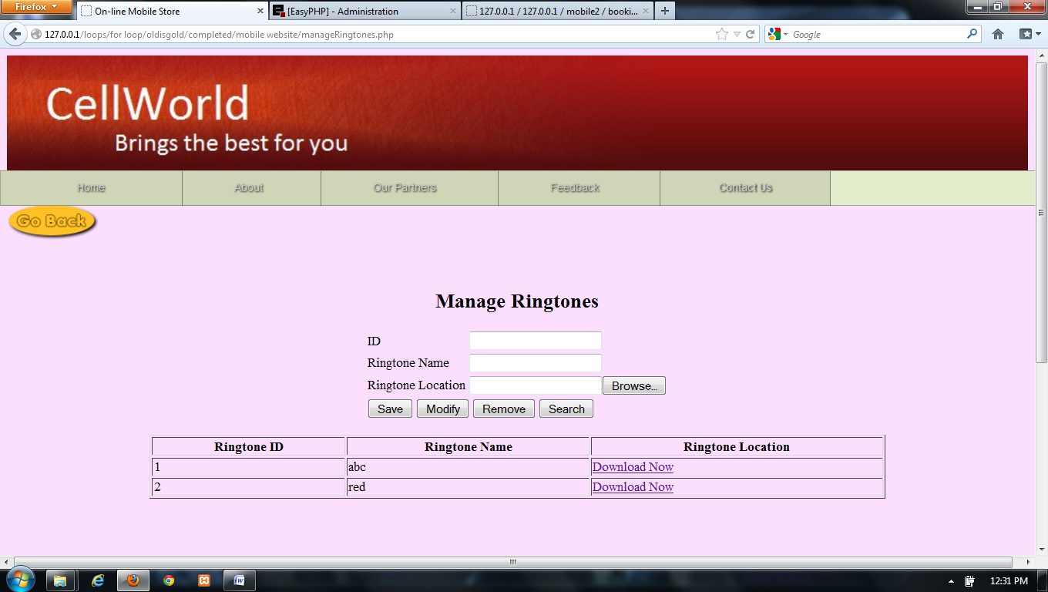
MANAGE RINGTONES PAGE

Slide 31
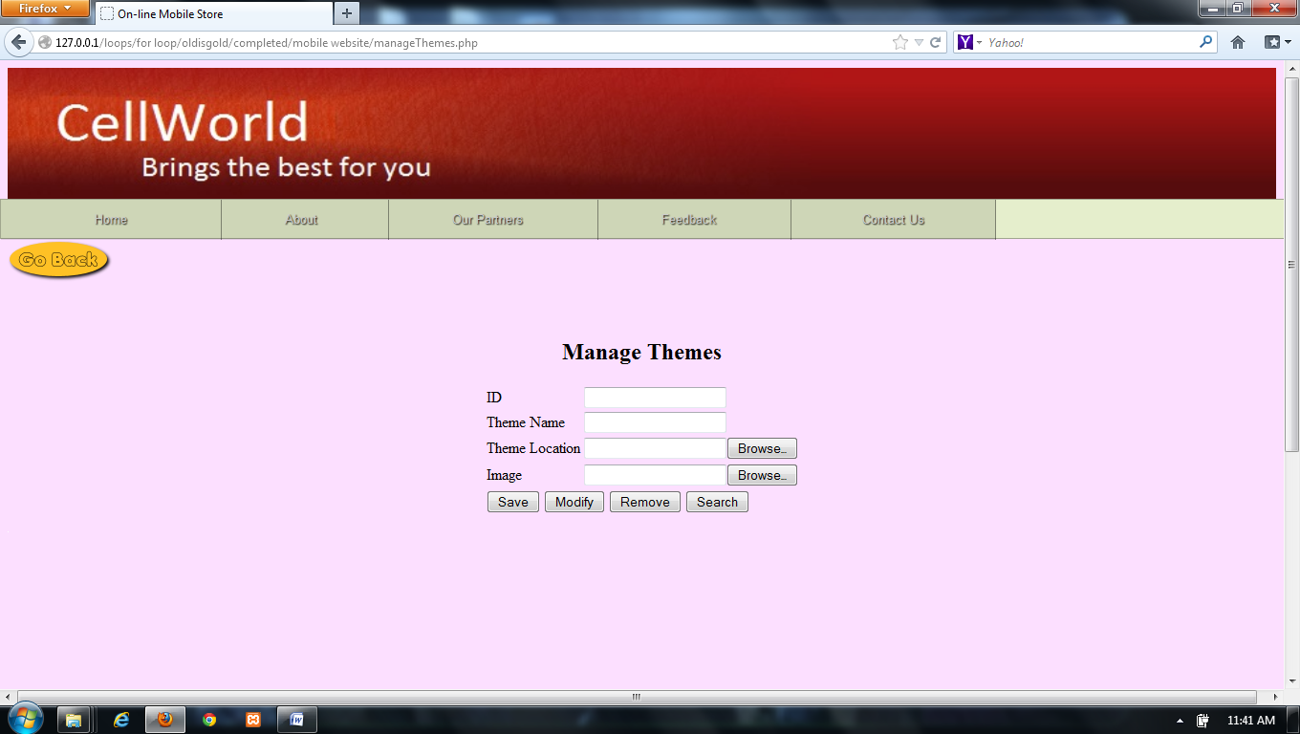
MANAGE THEMES PAGE

Slide 32
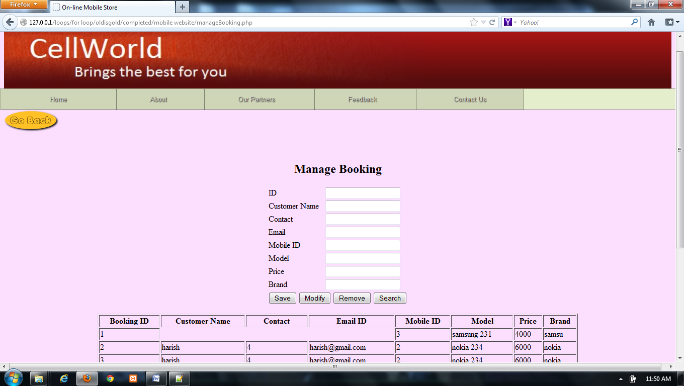
MANAGE BOOKING PAGE

Slide 33
CONCLUSION & FUTURE SCOPE
FUTURE SCOPE
This web application involves almost all the features of the online shopping. The future implementation will be online help for the customers and chatting with website administrator.
CONCLUSION
The project entitled “Online Mobile Shopping” is developed using PHP as front end and MYSQL database in back end to computerize the process of online buying and selling of mobiles in a showroom. This project covers only the basic features required.

Slide 34
BIBLIOGRAPHY
FOR PHP INSTALLATION
www.php.net
FOR DEPLOYMENT AND PACKING ON SERVER
www.developer.com
www.15seconds.com
FOR MYSQL
www.mysql.com
FOR PHP,CSS,APACHE
www.php.net
www.cssed.sourceforge.net
www.apache.org

Slide 35
THANKYOU

